Slide 1

Snagit Screen Capture Tool
Jane Smith
Western Governor University

Slide 2

Snagit Screen Capture Software
Snagit, a screen capture product by TechSmith, is a perfect tool for providing more direct and visually appealing feedback to students on their written work.
Today’s Agenda:
1. What is Snagit?
2. What are the benefits to adopting Snagit at WGU?
Image Credit (eCrater, n.d.)

Slide 3
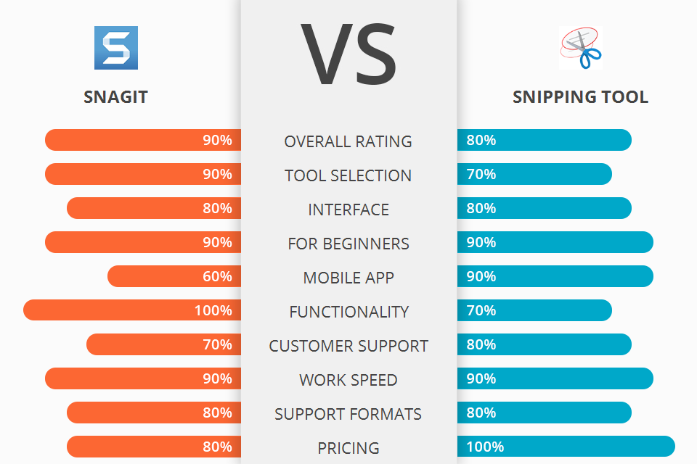
Snagit allows users multiple ways to capture their screens Snagit allows advanced editing It gets higher or the same scores on many key features.
Compared to the Microsoft Snipping Tool:
Image Credit:
(Williams, 2022)

Slide 4
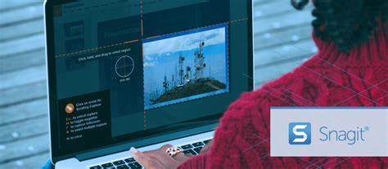
Snagit: Multiple Ways to Create
Create from Templates: You can use pre-made layouts to create tutorials and training materials.
Create Video from Images: You can talk and draw over several screenshots to make demonstrations.
Enterprise Sharing Destinations: You can share directly to Slack and Box.
Image Credit:
(University of Sheffield, n.d.)

Slide 5
Snagit Features (Wilson & Minor, January 11, 2022)
All-in-One Capture: Capture desktop or a section of your screen.
Scrolling Screen Capture: Grab vertical and horizontal scrolls.
Capture Text: Cut and paste text from Snagit to other documents.
Screen Recorder: Make video recordings.
Record Webcam: Toggle between webcam and recorder.
Animated GIFs: Turn any short .mp4 file into an animated GIF.
Edit Video Clips: Trim unwanted sections of video.

Slide 6
Benefits to Adopting Snagit
Current tools are inadequate to support the best feedback to students.
Snagit will bypass problems with Microsoft programs and varying Email programs.
With Snagit, faculty will know what the student sees because there are no longer differences between Microsoft and Email versions.
Students won’t miss the comments because they have them turned off.
Snagit comments and drawings will always appear where they need to in the student’s work.

Slide 7
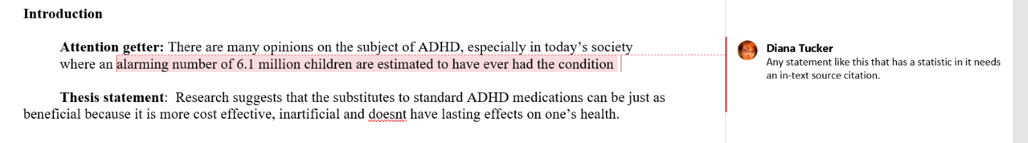
Microsoft Example
Image Credit (Personal Screen Shot)

Slide 8
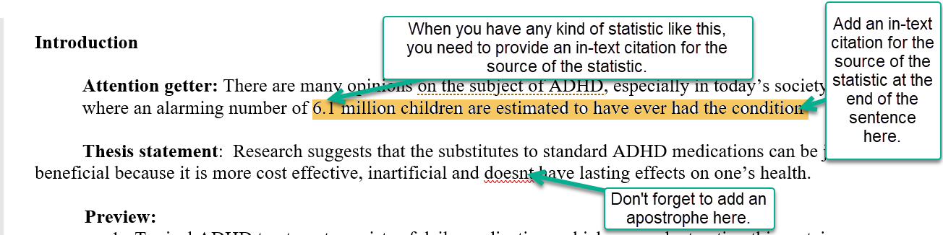
Snagit Example
Image Credit (Personal Screen Shot)

Slide 9
Conclusion
Snagit will provide more direct and visually appealing feedback to students on their written work.
Today I talked about:
1. What is Snagit?
Award-winning screen capture software
Expands options for feedback to students
2. Benefits to adopting Snagit at WGU
Current tools are inadequate
Snagit allows more uniformity
Snagit makes feedback clearer

Slide 10
References
eCrater. (n.d.). TechSmith Snagit 2020 (new! latest version). Retrieved July 13, 2022, from https://www.ecrater.com/p/35889115/techsmith-snagit-2020-latest-version
University of Sheffield. (n.d.). Snagit: The Swiss Army Screenshot Tool for Teachers. Retrieved July 13, 2022, from https://trainingfoundry.co.uk/snagit-the-swiss-army-screenshot-tool-for-teachers/
Williams, E. (2022). Snagit vs. Snipping Tool. Fix the Phone Publisher. Retrieved July 27, 2022, from https://fixthephoto.com/snagit-vs-snipping-tool.html
Wilson, J. L. & Minor, J. (January 11, 2022). Snagit review: A powerful, feature-rich screen-capture app. Retrieved July 13, 2022, from https://www.pcmag.com/reviews/snagit

